Slide 1
Math 530/630: CM 4.4 Classical Inference: Hypothesis Testing and Confidence Intervals

Slide 2

Remember, statistics…
2 main reasons we love them:
Sometimes they are estimators for population parameters we care about
Sometimes they are test statistics, i.e. the basis for a hypothesis test
Notes:
Estimators (like the mean) need confidence intervals

Slide 3
General idea for an estimator
Sample estimates are our “best guesses” for population parameters
Such a best guess is called a point estimate. We know, however, that point estimates — which are sample statistics, like the sample mean x — vary from sample to sample.
Interval estimate, i.e. confidence interval, provides a set of possible values for that parameter value that are “compatible” with the data
Construction of confidence interval requires knowledge of the estimator’s distribution
Known distribution
Simulated distribution (e.g., “bootstrapping”)
Notes:
Set of possible parameters that are compatible with my data

Slide 4
Bootstrapping
Idea: Simulate the population sampling distribution by repeatedly selecting samples (with replacement) and computing the desired statistic.
Motivation: Since the sample came from the population of interest, it can be used to estimate that population, and determine the Confidence Interval.

Slide 5
Confidence Intervals
Typically, a confidence interval takes the form:
point estimate ± a margin of error
We’ll come back to this…

Slide 6
General idea for hypothesis testing
Partition the parameter sample space into two regions
One region is defined by the null hypothesis: H₀
Usually what you wish to see evidence against
If the parameter estimate based on my sample is null/dull, then it will fall in this region (given some reasonable amount of random variation)
Other region defined by the alternative hypothesis: H₁
Usually what you wish to see evidence in support of
If the parameter estimate based on my sample is interesting, then it will fall in this region (and thus, outside of the null/dull region)
This is traditional null hypothesis significant testing (NHST)
Also called reject-support hypothesis testing
Notes:
Lots of possible parameters, and hypotheses about them
Other paradigms than reject-support. NEVER accept.

Slide 7
General idea for a test statistic
A numerical summary used to collapse sample data into a single number
When “big” or “extreme”, suggests that the observed data is very unexpected under the null hypothesis H₀
A p-value quantifies this incompatibility between the data and H₀ – specifically, it’s a tail probability
So, to get a p-value, you must know or approximate the probability distribution of the test statistic under the null H₀
This means we need to know what the null sampling distribution looks like
Notes:
Condense a sample down to a statistic, and have a hypothesis about it
Conditioned on null – what would dist look like if null were true? How does H1 compare?

Slide 8
Therefore…
To complete a hypothesis test or convey the precision of a point estimate, we need the statistic’s or estimator’s sampling distribution
“sampling” here should invoke “long-run”, “hypothetical repeats of the experiment”
For an estimator, the standard deviation of the sampling distribution is called the standard error
Notes:
Won’t see the sampling distribution – use probability theory to infer (under assumptions)
Like the - Recall SEM = sigma/sqrt(n=sample size)
Different SE calc for different random vars/ distributions

Slide 9
Process
Write down null and alternative hypotheses
Figure out good test statistic that estimates the parameter you are interested in (i.e., what numeric summary based on your sample captures what you want)
Work out null distribution for that statistic (known or simulated)
Calculate p-value (or critical value) by comparing actual value to null distribution
Reject H₀ if probability (p-value) < 𝝰
Notes:
Difference in means, medians
Proportion and diff in proportion

Slide 10
Hypotheses
Null hypothesis = H₀
Alternative hypothesis = H_{a} / H₁
Hint: we have to know the null distribution, so H₀ will always be of the form:
Some parameter = some value as in…
µ = 0
Notes:
Notation

Slide 11
The null distribution
If we know the population distribution, we can “construct” the null distribution: the distribution of a test statistic if the null hypothesis is true
If we don’t know the population distribution, we can simulate it using resampling
In the two sample scenario, this means we resample observations from our sample data without replacement, each time reshuffling the "sample" or "group" assignment (a la Sneetches).

Slide 12
Permutation testing
Idea: Simulate the sampling distribution under the null hypothesis by shuffling the group labels repeatedly and computing the desired statistic.
Motivation: If the labels really don't matter, then switching them shouldn't change the result! We do this when we want to test whether observations from two groups follows the same distribution, without making any assumptions about the shape of that distribution (e.g., normality).

Slide 13

Building Intuition – Aspiring astronauts
Inspired by Alan Shepard, the first American to journey into space, a 14-year-old Hillary Rodham from suburban Chicago wrote a letter to NASA in 1961 asking what she needed to do to become an astronaut.

Slide 14

Let’s pretend
Upon receipt of the letter in 1961, NASA decided to conduct a study to test whether girls who are aspiring astronauts in high school have “above average” IQ

Slide 15
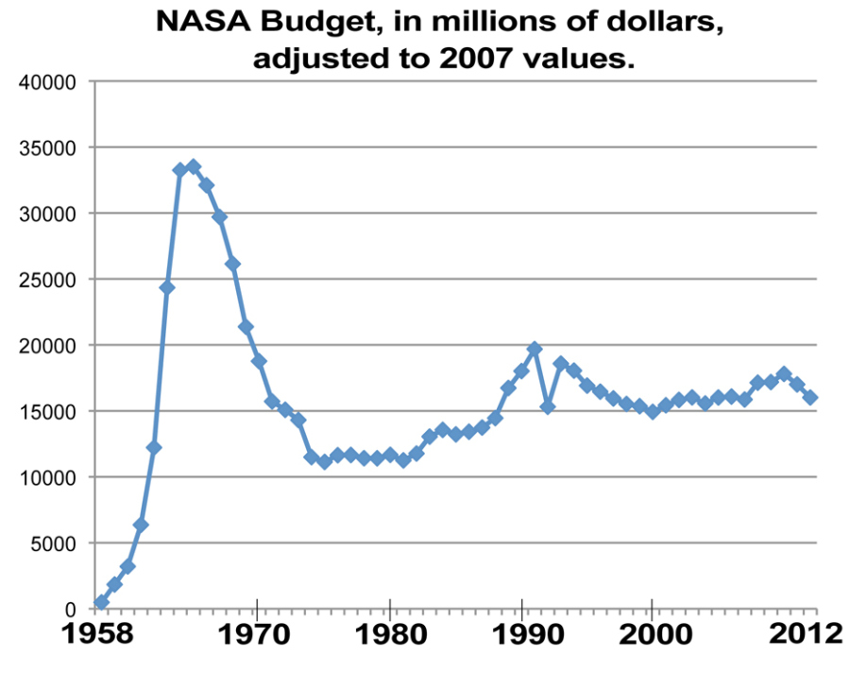
The (fictitious) study
Unfortunately, the NASA budget in 1961 was pretty low
So they studied only 25 high school girls, all of whom were aspiring astronauts (AA)
Population (normally distributed): µ = 100; 𝞼 = 15

Slide 16

A (directional) alternative hypothesis
H₀:
AA will have lower or comparable IQs;
H₁:
AA will have higher IQs;

Slide 17
Rearrange…
H₀:
AA will have lower or comparable IQs;
H₁:
AA will have higher IQs;

Slide 18
Obtaining a test statistic
We know the population mean and standard deviation.
µ = 100
𝞼 = 15
A general formula for any test statistic about some generic parameter, θ:
?What are these values?
Notes:
Using what we know about the population and the statistic of interest
Theta Hat – estimate based on the sample
Theta – statistic based on hypothesis (mean, etc)
Theta – estimate based on the null dist (in this case assumed and known)
2 we know, 1 we don’t, yet…

Slide 19
Let’s pretend we live in a crazy 1960’s world, and NASA interns calculated just the sample mean and not the standard deviation before they “lost” the data. Luckily, we know µ and 𝞼.
What is the NULL distribution of this test statistic?

Slide 20
Before we even look at the data: What is the mean and standard deviation (the “standard error”) of the null distribution? What shall we assume this distribution looks like? Draw it! Let 𝝰 = .05, 1- tailed: What value does our sample mean need to “beat” in order for us to conclude that it is higher than the population mean (given random variation present in our sample)? Draw this! What would you conclude if our sample mean is 104? What if it is 108?
Your Turn

Slide 21
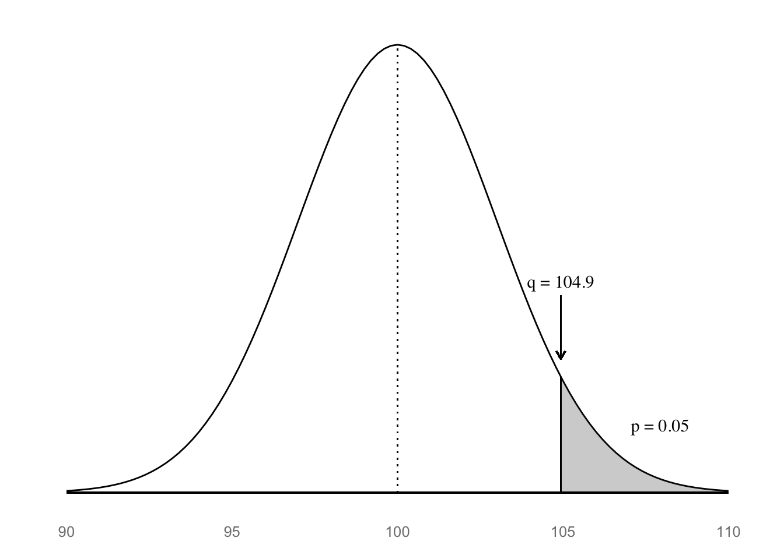
The null distribution for the z-statistic (normal)

Slide 22
A (non-directional) alternative hypothesis
H₀:
IQ scores for AA will not differ from population;
H₁:
IQ scores for AA will be different from population;

Slide 23
Before we even look at the data: What is the mean and standard deviation (the “standard error”) of the null distribution? What shall we assume this distribution looks like? Draw it! Let 𝝰 = .05, 2- tailed: What value does our sample mean need to “beat” in order for us to conclude that it is different than the population mean (given random variation present in our sample)? Draw this! What would you conclude if our sample mean is 105?
Your Turn

Slide 24
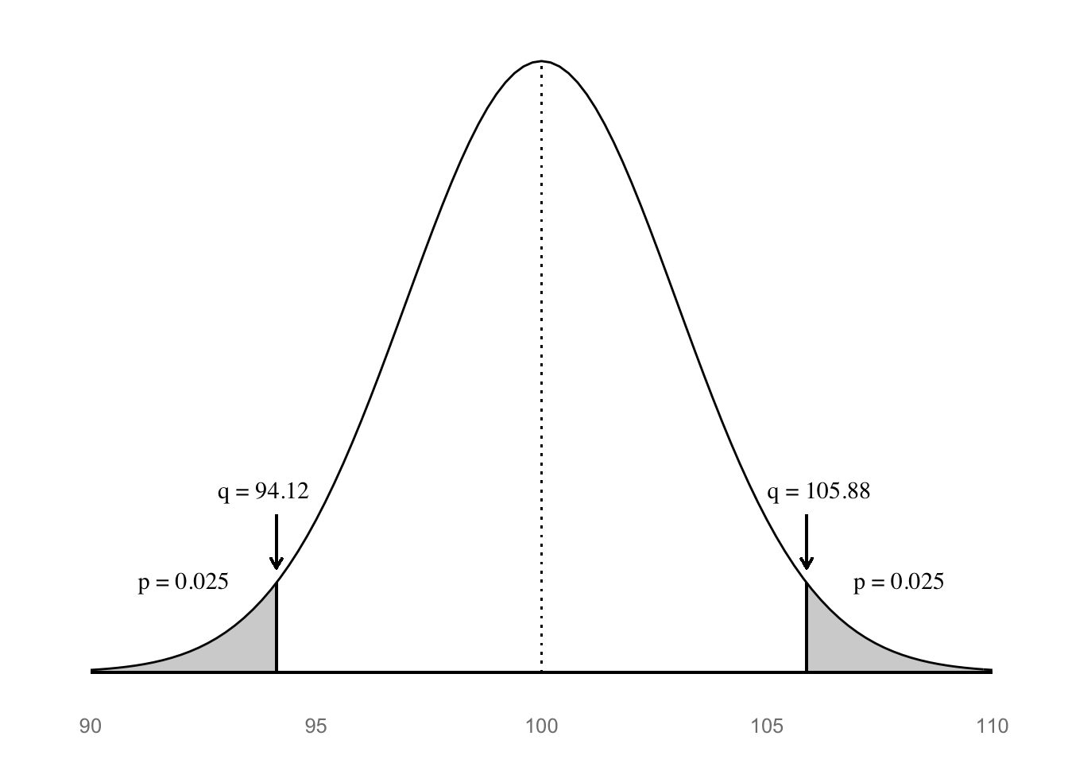
The null distribution for the z-statistic (normal)

Slide 25
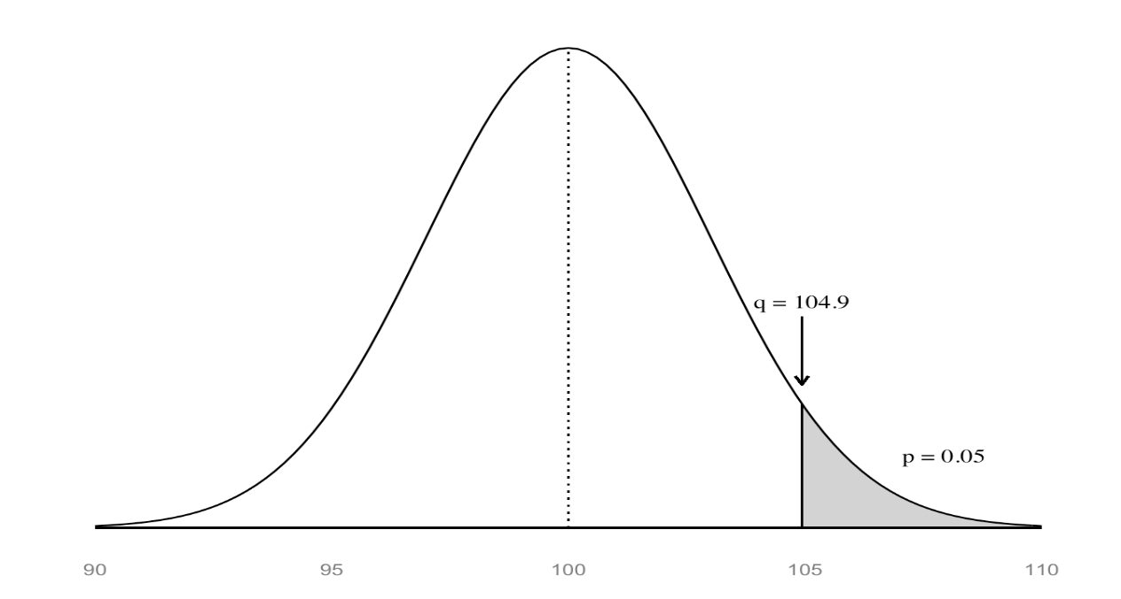

The alternative hypothesis
Directional H₁
Non-directional H₁
1 tailed
2 tailed
2 tailed
Notes:
What if the sample mean is 105.5?

Slide 26


Slide 27
One sample means z-test
Notes:
We have moved this far without even looking at our data!

Slide 28

And the sample mean is…

Slide 29
One-sample z-statistic
Does the sample perform differently than general population (known: μ & σ)?
Notes:
Ahhh, the famous z-score!!
Restates the data into z standard errors from the known population mean.
Put on board?

Slide 30
One-sample z-statistic
For known:

Slide 31
One-sample z-statistic
For known:
Notes:
What does this tell us??
Is it signf? Does it support the alternative hypothesis?

Slide 32
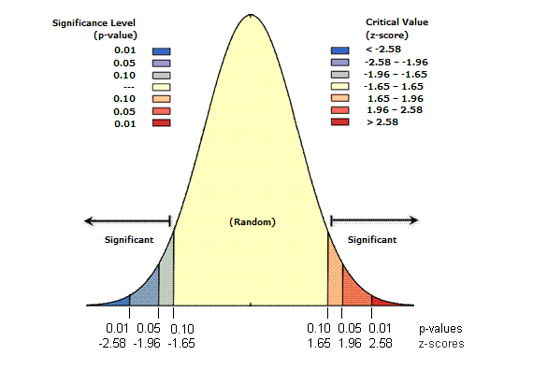
Z-statistic – Now what? Critical Values
Determine z_{critical} values for your α…
Must “beat” ±1.65 for α = .10, 2-tailed, to reject null
Must “beat” ±1.96 for α = .05, 2-tailed, to reject null
Must “beat” ±2.58 for α = .01, 2-tailed, to reject null
Not shown…
Must “beat” ±1.28 for α = .10, 1-tailed, to reject null
Must “beat” ±1.65 for α = .05, 1-tailed, to reject null
Must “beat” ±2.32 for α = .01, 1-tailed, to reject null
Notes:
Table lookup –
The “other” confidence region – beware!!
p< , not ==, computers!

Slide 33
General idea for a p-value
Probability under the null H₀ of observing a test statistic value as or more extreme than that computed from the observed data (your sample data)
The p-value is not the probability that the null hypothesis is true
Example in a two-sided test, i.e. when both very small and very large values of test stat are “extreme”:

Slide 34
“A p-value is a measure of how embarrassing the data are to the null hypothesis”
--Nicholas Maxwell
Maxwell (2004). Data Matters: Conceptual Statistics for a Random World. Emeryville, CA: Key College Publishing.

Slide 35
Cut-offs
Whether we like to admit it or not, p-values ultimately are cut-offs:
p-value < 𝝰 | p-value ≥ 𝝰
Hit | Not hit
Statistically significant | Not statistically significant
Fame and glory! | ?
Reject H₀ | Accept H₀ (cringe) Fail to reject H₀ (eye-roll)
Notes:
What’s a “good” p-value?
History of alpha (tables) 0.1, 0.05. 0.01
Field dependent.

Slide 36
P-value
Standardized measurement of evidence
Measure of probabilistic significance, not conceptual.
LOW P-VALUE: low probability of sample looking like the null population
Decision → reject the null
HIGH P-VALUE: high probability of sample looking unlike the null
Decision → do not reject null
Notes:
Many readings – statistically significant does not mean interesting
“there is sufficient evidence to support the hypothesis that…”

Slide 37

Obtaining the p-value for our z-statistic
One-tailed
pz_up <- 1 - pnorm(z)
Two-tailed
pz_2 <- 2*pz_up
c(pz_up, pz_2)
[1] 0.04779035 0.09558070
Notes:
Permutation – built dist, counted extremes – empirically arrived at the p-value
Now a formula

Slide 38
Obtaining the p-value for our z-statistic
One-tailed
pz_up <- 1 - pnorm(z)
Two-tailed
pz_2 <- 2*pz_up
c(pz_up, pz_2)
[1] 0.04779035 0.09558070
Notes:
How would you get the critical values in R?
How would you compute the critical values?
Qnorm(.025), qnorm(.975)

Slide 39
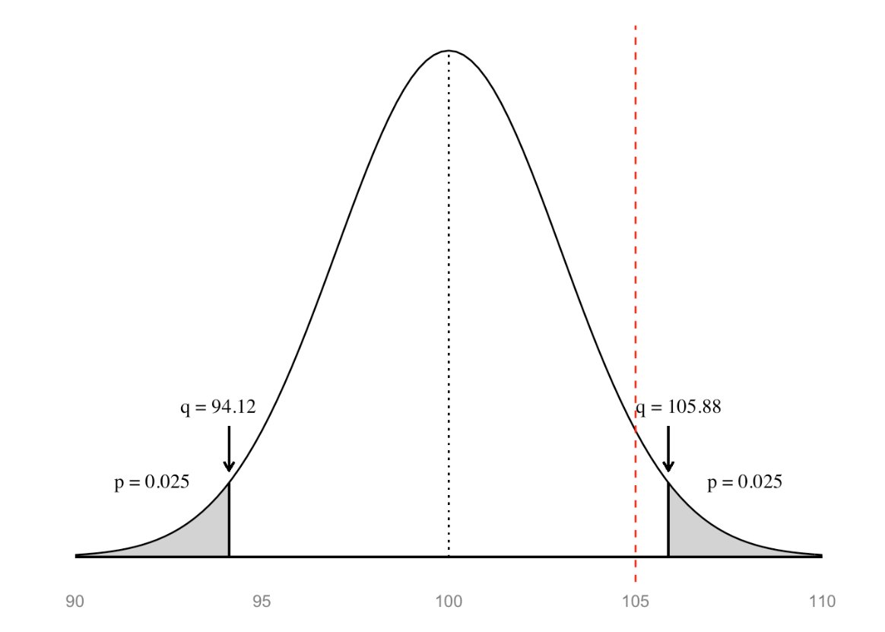
Two-tailed p-values more generally…
pz_1tail <- min(pnorm(z), 1 - pnorm(z))
pz_2tail <- 2 * pz_1tail
pz_2tail
[1] 0.0955807
Cut-off values
Lower <- qnorm(.025, 100, 15/sqrt(25))
Upper <- qnorm(.975,100,15/sqrt(25))
→ p = .0955
Notes:
Instead of making your data look like the unit-normal,
Make the unit-normal look like your data.

Slide 40
When the null hypothesis is true
1-sample z-test
n = 25

Slide 41
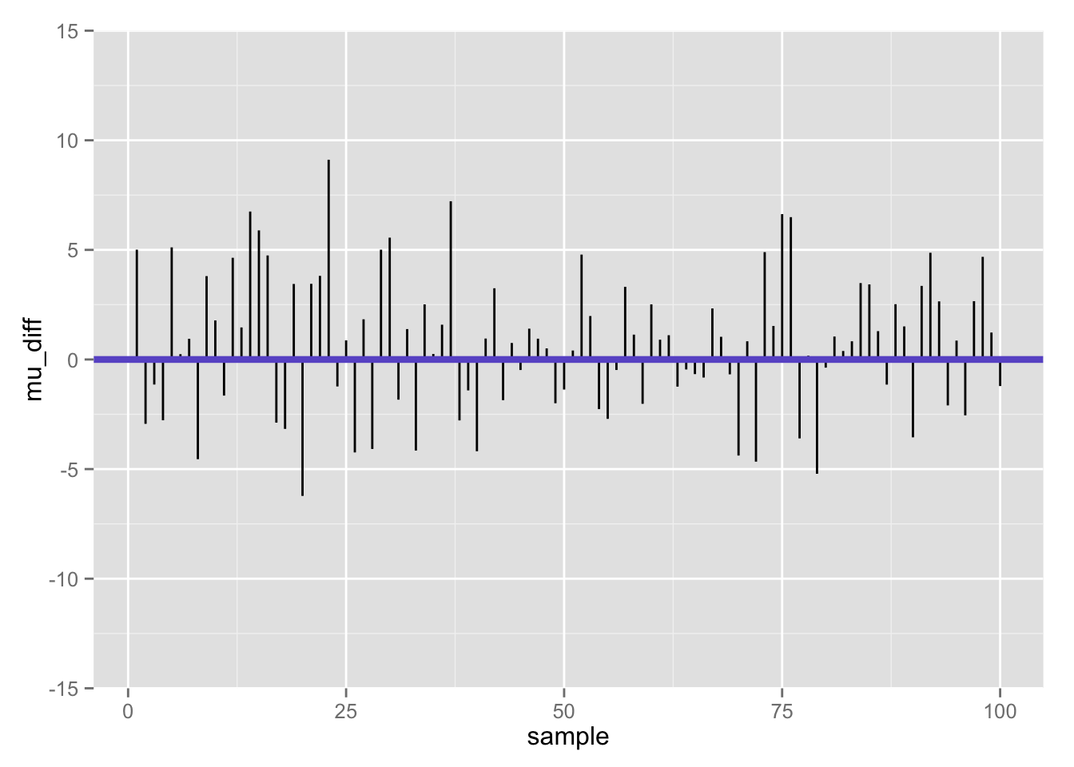
Differences between population mean and sample mean (100 samples) when null is true

Slide 42
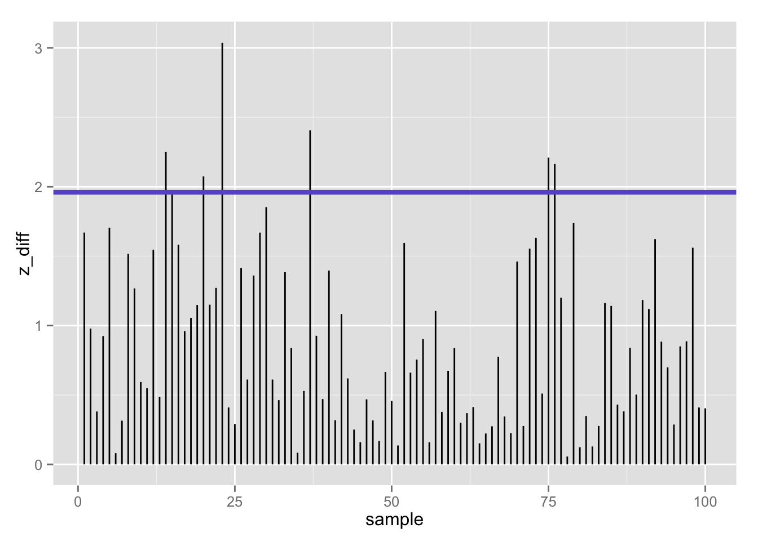
100 z-statistics (absolute value) when null is true: 7% false positives using z-test (𝛂 = .05/2)

Slide 43
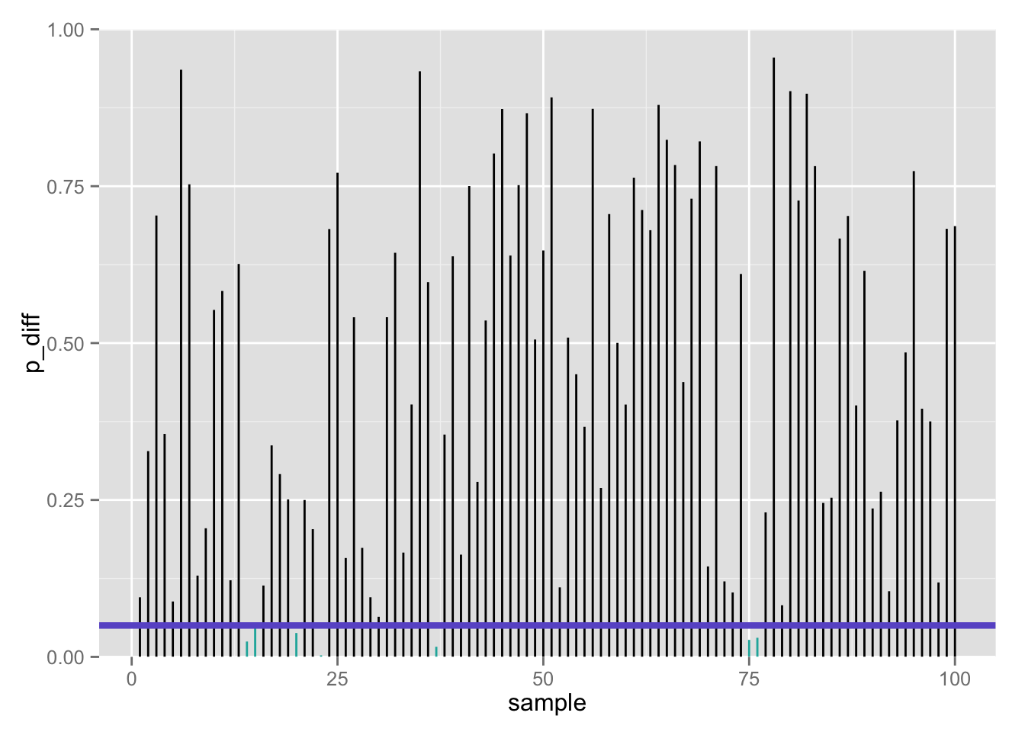
100 p-values when null is true: 7% false positives using z-test (𝛂 = .05/2)

Slide 44
One sample means T-test

Slide 45
Now let’s vindicate our poor NASA interns: we have found the actual sample data, and now can calculate both the sample mean and standard deviation. We’ll use the sample standard deviation (s = 13) to estimate the population s.d. (𝞼).
What is the NULL distribution of this new test statistic?
Notes:
More realistic situation!

Slide 46
Obtaining a test statistic
Remember our general formula for any test statistic about some parameter, θ:

Slide 47
Using the sample estimate of the variance
Recall the sample estimate of the population variance:
The t-statistic formula is:
At this point, you may be worried about the effect of variability of the variance estimate
You would be right: the random variable, t, is no longer normally distributed
It has a unique distribution: the t-distribution, with n-1 degrees of freedom
The t-distribution is asymptotically normal

Slide 48
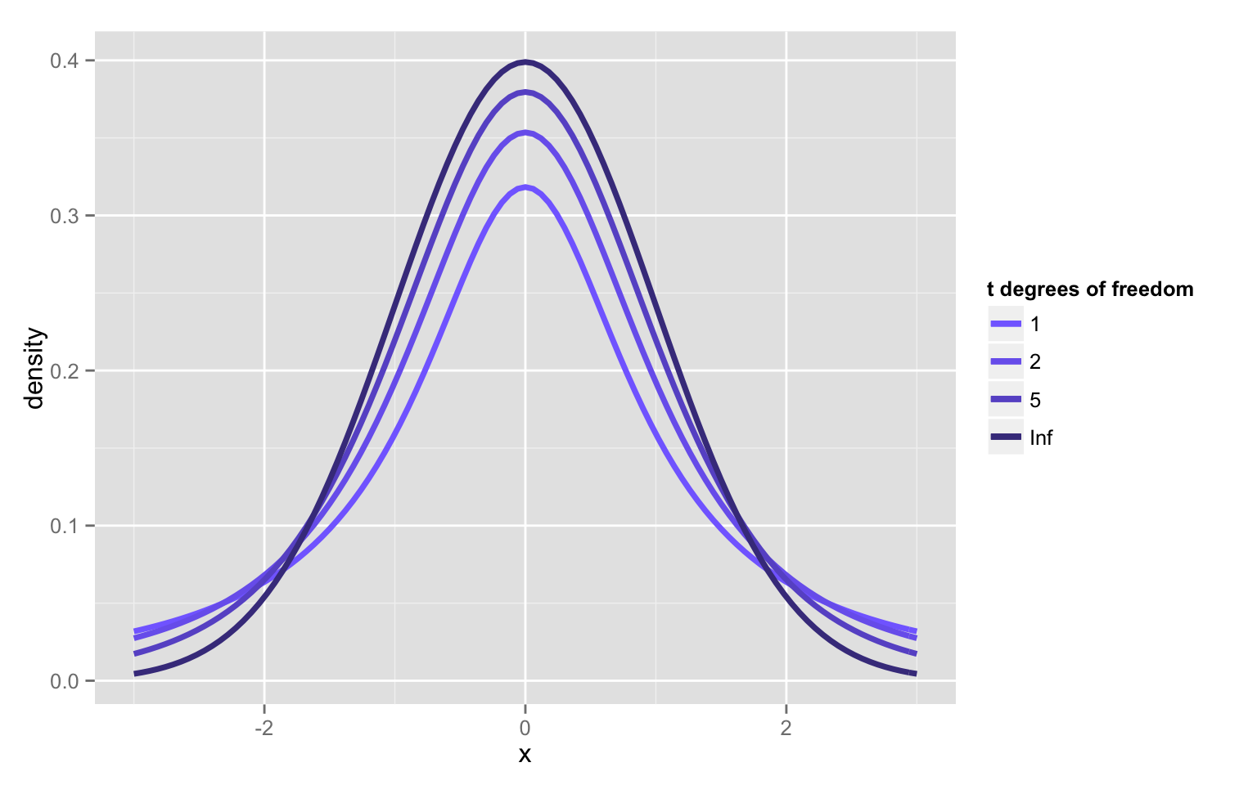
New distribution family: student’s t

Slide 49
The t-distributions: PDFs
Symmetric (skewness = 0)
Bell-shaped, but notice that the t always has always has relatively more AUC in the tails vs. the unit-normal, and unit-normal has relatively more scores in the center; thus t-distribution is “leptokurtic”
Kurtosis is undefined for t-variables with df < 4

Slide 50
The t-distributions
Let T denote a random variable with a t-distribution with df degrees of freedom. Then:
E(T) = 0; same as unit-normal
Var(T) = df/(df-2); more spread out than unit-normal (↑ variance)
As df increases, the t- distributions converge to the unit normal.
t-distributions will be useful for statistical inference for one or more populations of quantitative variables.

Slide 51
Red = z, blue = t
n = 4 (×10,000 simulations)
n = 9 (×10,000 simulations)

Slide 52
Red = z, blue = t
n = 16 (×10,000 simulations)
n = 25 (×10,000 simulations)

Slide 53
Q-Q Plots of rt(100,df)
t with df=4
t with df=30

Slide 54
One-sample t-test

Slide 55
One-sample t-test

Slide 56
One-sample t-test
Does sample perform differently than general population (known: μ, unknown: σ)?
Now what?
Determine t_{critical} values for your α and df
Must “beat” that value to reject null
α = ?
df = ?
t_{critical} = ? Is it directional?
p?
Notes:
Old school!
But, luckily, we have computers!!

Slide 57
What is the p-value for the t statistic?
One-tailed, upper
pt_up <- 1 - pt(t, n – 1)
Two-tailed
pt_2 <- 2 * pt_up
c(pt_up, pt_2)
[1] 0.03320682 0.06641363

Slide 58
What is the p-value for the t statistic?
One-tailed, upper
pt_up <- 1 - pt(t, n – 1)
Two-tailed
pt_2 <- 2 * pt_up
c(pt_up, pt_2)
[1] 0.03320682 0.06641363
Notes:
Thus, the danger of playing with your tails…

Slide 59
One-sample t-test in R
Have to have actual data- not just sample statistics
So far, I have only been playing with sample statistics- I didn’t actually have sample data! Let’s make up some sample data with the sample mean/sd we need:
set.seed(1)
iq_aa <- seq(83.8, 126.2, length.out = 25)
mean(iq_aa) # perfect!
[1] 105
sd(iq_aa) # close enough!
[1] 13.00231

Slide 60
One-sample t-test in R
aat <- t.test(iq_aa, mu = 100) # Ho: mu = 100
aat
One Sample t-test
data: iq_aa
t = 1.9227, df = 24, p-value = 0.06646
alternative hypothesis: true mean is not equal to 100
95 percent confidence interval:
99.63291 110.36709
sample estimates:
mean of x
105
# Recall our previous 95% confidence interval- pretty close!
c(lowert, uppert)
[1] 99.63386 110.36614
Two-tailed test
Notes:
P-vale and confidence interval

Slide 61

Mansplain it to me…
devtools::install_github(c("hilaryparker/explainr", "hilaryparker/mansplainr"))
mansplain(aat)
That's great that you were able to do a hypothesis test. You got a p-value of 0.066459. That means it's not significant at alpha = .05, but that's OK. The important thing is that you tried.

Slide 62

Complain about it…
devtools::install_github(c("hilaryparker/explainr", "hilaryparker/complainr"))
complain(aat)
This hypothesis test had a p-value of 0.0664587.
That's if you can trust any frequentist method. You should really be doing a Bayesian analysis. Did you hear about that journal that banned p-values?

Slide 63
Family of t-tests
One-sample t-test for a single mean
Two-sample t-test (independent samples) for comparing 2 means
Two-sample t-test (correlated samples; dependent samples) for comparing 2 means with correlated or repeated measures

Slide 64
Confidence Intervals

Slide 65
Confidence interval for µ
Margin of Error
Critical Value!
Notes:
Symmetric!!
Required when bootstrapping?

Slide 66
Calculating 95% CI for µ in R, 𝞼 unknown
# sample statistics
xbar <- 105
s <- 13
n <- 25
# margin of error
me <- qt(.975, n - 1) * (s/sqrt(n)) # .975 --> .025 at EACH tail
# 95% confidence intervals
lowert <- xbar - me
uppert <- xbar + me
c(lowert, uppert)
[1] 99.63386 110.36614
Two-tailed CI
Is µ = 100 in there??
Notes:
If we find the range of possible values for the population underlying our sample,
Is the null mean in there?
Then our mean isn’t so special, is it?

Slide 67

Let’s attempt to summarize…
We are 95% confident that the IQ for AA HS girls in this sample is between 99.12 and 110.88.
This is not correct:
A confidence interval is for a population parameter, and cannot be applied to individuals in the sample.

Slide 68
Let’s attempt to summarize…
95% of all samples of AA HS girls will give an average IQ between 99.12 and 110.88.
This is not correct:
Each sample will give rise to a different confidence interval- 95% of those intervals will contain the true mean.

Slide 69
Let’s attempt to summarize…
There is a 95% chance that the true mean IQ for AA HS girls is between 99.12 and 110.88.
This is not correct:
µ is not random. The probability that µ is between 99.12 and 110.88 is either 0 or 1.

Slide 70

You got it…
We are 95% confident that the population mean IQ of AA HS girls is between 99.12 and 110.88.
This is correct!:
The confidence interval is based on the sample, and hence is random. There is a 95% probability that the interval (99.12, 110.88) contains µ.

Slide 71
The “Other” Confidence Interval
Determine z_{critical} values for your α…
Must “beat” ±1.65 for α = .10, 2-tailed, to reject null
Must “beat” ±1.96 for α = .05, 2-tailed, to reject null
Must “beat” ±2.58 for α = .01, 2-tailed, to reject null
Not shown…
Must “beat” ±1.28 for α = .10, 1-tailed, to reject null
Must “beat” ±1.65 for α = .05, 1-tailed, to reject null
Must “beat” ±2.32 for α = .01, 1-tailed, to reject null
Notes:
The “other” confidence region – NULL dist. Beware!!
Region of acceptance/rejection – totally about critical values and the # to beat.

Slide 72
Hypothesis Tests and Confidence Intervals
Suppose: z-test with α = .05, 2-tailed
H₀:
H₁:
I will reject H₀ if:
Some algebra to re-arrange, I will reject H₀ if:
And I will not reject H₀ if μ lies between those 2 rejection points:
This is my 95% confidence interval for μ

Slide 73
Hypothesis Tests and Confidence Intervals
The confidence interval also tells when to reject H₀
I will reject H₀ if μ is outside of this interval:
But what if instead of solving for μ, I solve for the sample mean?
I will reject H₀ if:
These two values define both of my regions of rejection (2-tailed).
My region of non-rejection is all values in between those 2 rejection points
I will not reject H₀ if my sample mean is within:

Slide 74
Regions of rejection/non-rejection: What if I observe a sample mean = 106?
Rejection regions I reject if: or if:
Non-rejection region I will not reject if:
With observed sample mean=106, I reject H₀

Slide 75
Confidence interval: What if I had hypothesized μ = 100?
95% confidence interval I will not reject H₀ if μ is within:
Because μ=100 is not contained in this interval, I reject H₀ as it does not contain my population value
Note that this is the same decision I reached with my regions of rejection
I also know more than I did before: I know that I am 95% confident that the true value of μ is between 100.12 and 111.88

Slide 76
Reject H₀…
ROR:
If the sample mean is outside the region of rejection.
Confidence Interval:
If the null hypothesis mean is outside the Confidence Interval.
RoR: μ = 100 (population parameter / hypothesized value)
Given that μ = 100, is my sample mean a reasonable value from that population?
Confidence interval: μ = 106 (sample statistic)
Given that my sample mean = 106, is μ a reasonable value for the population mean?
Notes:
Note: The standard deviation used to create both sampling distributions is 3. Why?

Slide 77
Interpreting significance in NHST
Non-significance ≠ true null hypothesis
Suppose we fail to reject the null because p > .05
We cannot assume then that null is true, but merely that we lack sufficient evidence to reject it
It is all too easy to find non-significant results by conducting…
A poor study…
With poor measures…
And low power.
Consider: “Not guilty” verdict in a jury trial- prosecutor may have failed to present a strong case
Not guilty ≠ innocent
If you truly want to support the null, look into equivalence testing/tests of close fit

Slide 78
Confidence intervals provide several advantages over NHST alone
Provides bounded estimate of the population parameter
Permits tests of all possible null hypotheses simultaneously
You can reject/not reject H₀ not only for value hypothesized in H₀ but also for other hypothesized values
Interval width provides information about precision
Significance plus very narrow interval suggests power so great as to enable us to reject even a trivial effect
Non-significance with wide intervals suggests that our measures/procedures/experiment lacks precision
p-values do not give you this information, heavily influenced by sample size (n)

Slide 79
3 new distributions…
If you see the ratio of an independent normal random variable (numerator) to the square-root of a chi-squared variable (denominator; any time you have an SE on the bottom!),
think Student’s t.
If you see squares of normal random variables (or of their differences!),
think chi-squared.
If you see the ratio of two chi-squared random variables (i.e., sample variances from a normal distribution),
think F distribution.

Slide 80
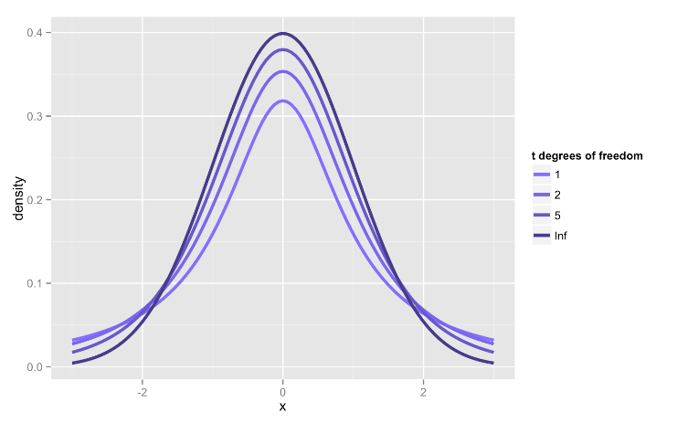
If you see the ratio of an independent normal random variable to the square-root of a chi-squared, think Student’s t

Slide 81
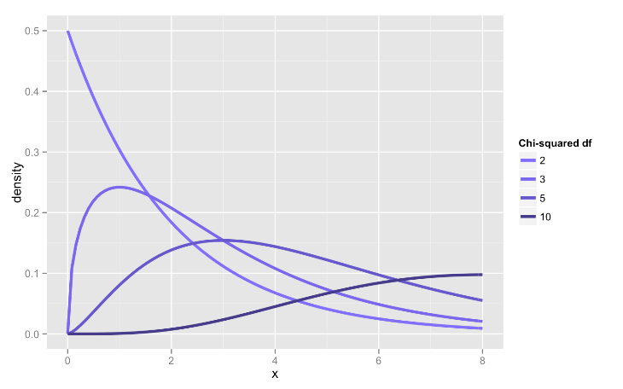
If you see squares of normal random variables, think chi-squared

Slide 82
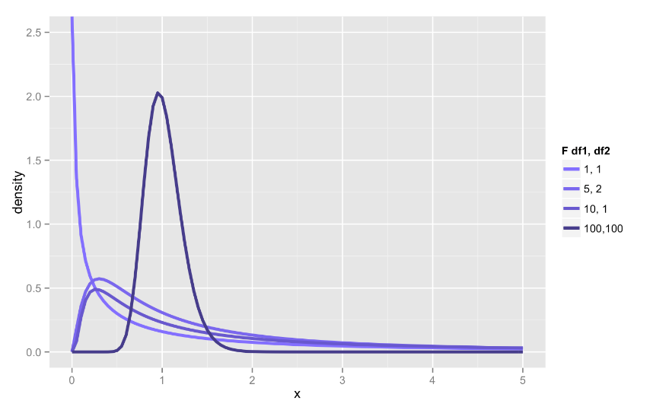
If you see the ratio of two chi-squared random variables (i.e., sample variances from a normal distribution), think F distribution

Slide 83
Done-ish…
References
Assumptions!!
Perfect T-test

Slide 84
Rationale for one sample T test
We collect sample data and calculate a sample mean.
If this sample come from the population we think it came from, then we would expect the sample mean to be approximately equal to the population mean.
Although they may differ by chance, we would expect large differences between sample means to happen infrequently.
Under the null hypothesis, we assume no difference in means.
We compare the the sample mean to the population mean to see if the difference is more than we would expect to get by chance under the null hypothesis.

Slide 85
Rationale for one sample T test
At alpha=.05, we therefore seek evidence that there is only a 5% chance that the magnitude of the difference we observe is consistent with what we would expect based on chance alone.
Remember: The *p*-value does not tell you if the result was due to chance. It tells you whether the results are consistent with being due to chance. These two things are not the same.
We use the standard error as the gauge of variability of the sample mean. If it is small, we expect most samples to have very similar means. If it is large, then large differences in sample means are more likely.

Slide 86
Rationale for one sample T test
If the difference between the sample means is larger than we would expect based on the standard error, then we know that one of two things has happened:
We made a mistake (boo!). There is no difference between the population and our sample means fluctuate a lot. By chance, we have collected a sample that is atypical of the population we drew from. Here, the difference is a fluke and the null is true; we incorrectly reject the true null hypothesis and thus commit a Type I error.
We made a discovery (yay!). The sample comes from a different population, that may be typical of THAT population. Here, the difference is genuine, and we correctly reject the null hypothesis.

Slide 87
From wikipedia…
The p-value is defined as the probability, under the assumption of the null hypothesis, of obtaining a result equal to or more extreme than what was actually observed.
Depending on how it is looked at, the "more extreme than what was actually observed" can mean
X ≥ x (right-tail event) or
X ≤ x (left-tail event) or
the "smaller" of X ≤ x and X ≥ x (double-tailed event).
Thus, the p-value is given by
Pr(X ≥ x|H) for right tail event,
Pr(X ≤ x|H) for left tail event,
2*min{Pr(X ≤ x|H),Pr(X ≥ x|H)} for double tail event.

Slide 88
http://math.stackexchange.com/questions/1493880/two-tailed-hypothesis-test-why-do-we-multiply-p-value-by-two

Slide 89
From Chihara & Hesterberg - permutation:
Say that you have one sample with *m* observations, and a second sample with *n* observations
Pool the m + n values
Repeat…
Draw a resample of size m without replacement
Use the remaining n observations for the other sample
Calculate the difference in means or another statistic that compares samples
…until you have enough samples
Calculate the p-value as the fraction of times the random statistics exceed the original statistic (note: “Exceeds” generally means ≥ rather than >)
Multiple by 2 for a two-sided test, or use abs()

